Slide 1

MSc Project Data Collection
13/Jan/2023

Slide 2
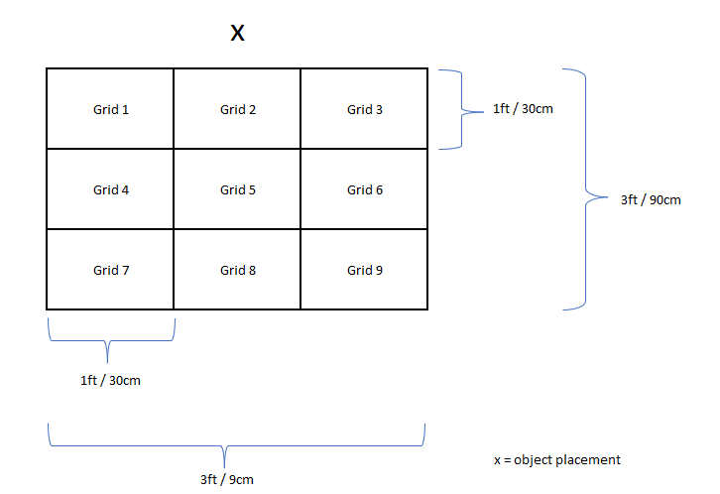
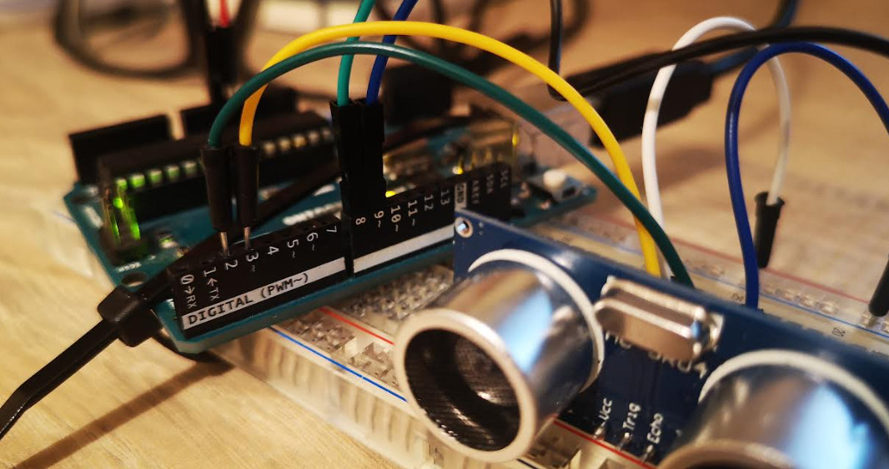
Overview
Data collected from a 3x3 grid, using an Arduino Uno and HC-SR04 ultrasonic sensors
Two ultrasonic sensors were used, referenced as Channel 1 (Ch1) and Channel 2 (Ch2)
Each channel collects approx. 100,000 samples
Data is collected for Ch1, then Ch2
It takes approx. 20 to 25 minutes to collect the data for both channels (depending on time of flight)

Slide 3
Data Capture
Data has been gathered from the following areas:
A hallway with a closed door to the left of the obstacle, and an open doorway behind the obstacle and wall a few metres behind the obstacle (referred to as Area A)
Same hallway as above, but away from any doors, with a wall and radiator a few metres behind the obstacle (referred to as Area B)
Information gathered:
Approx. 100,000 samples per channel
Timestamp for each sample
References for the start and end of channel data capture (in place to allow index refencing when post processing the data into final dataset)
Total time for data capture (per channel) in milliseconds

Slide 4
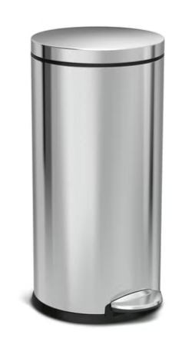
Obstacles
Data was for the following situations:
No obstacle in place
Closed door
Tall narrow bin (width: 30cm, height: 75cm approx.)
Storage box/cabinet (width: 40cm, height: 95cm)
Narrow, round display stand (width: 20cm, height: 70cm)

Slide 5
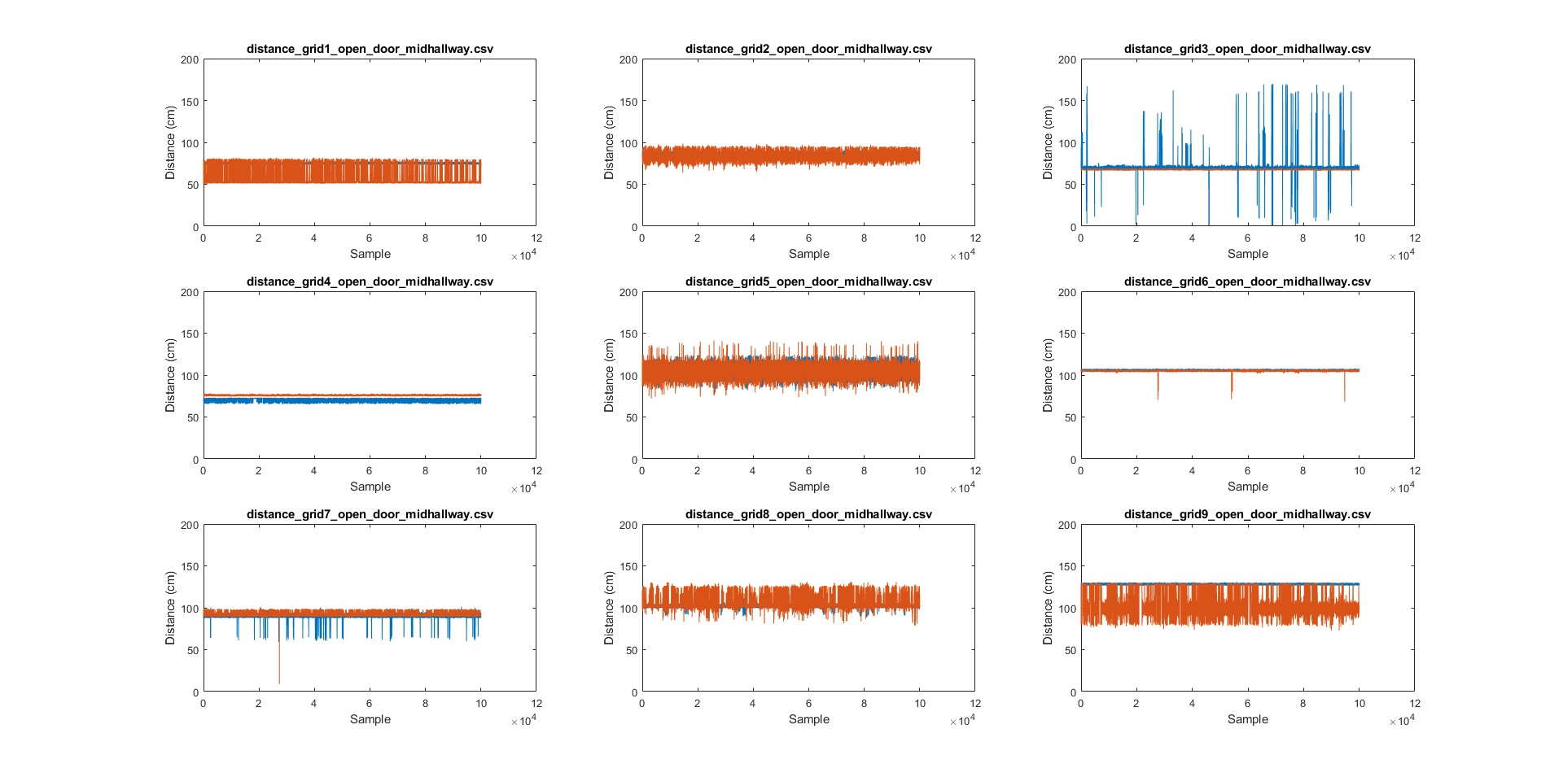
Empty Hallway (Area A)
X

Slide 6
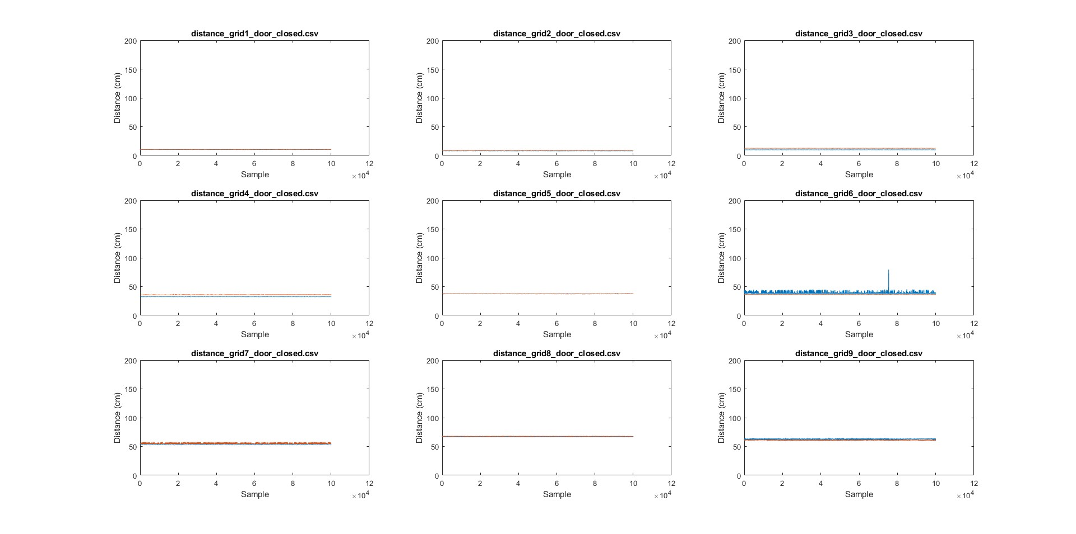
Closed Door (Area A)
X

Slide 7
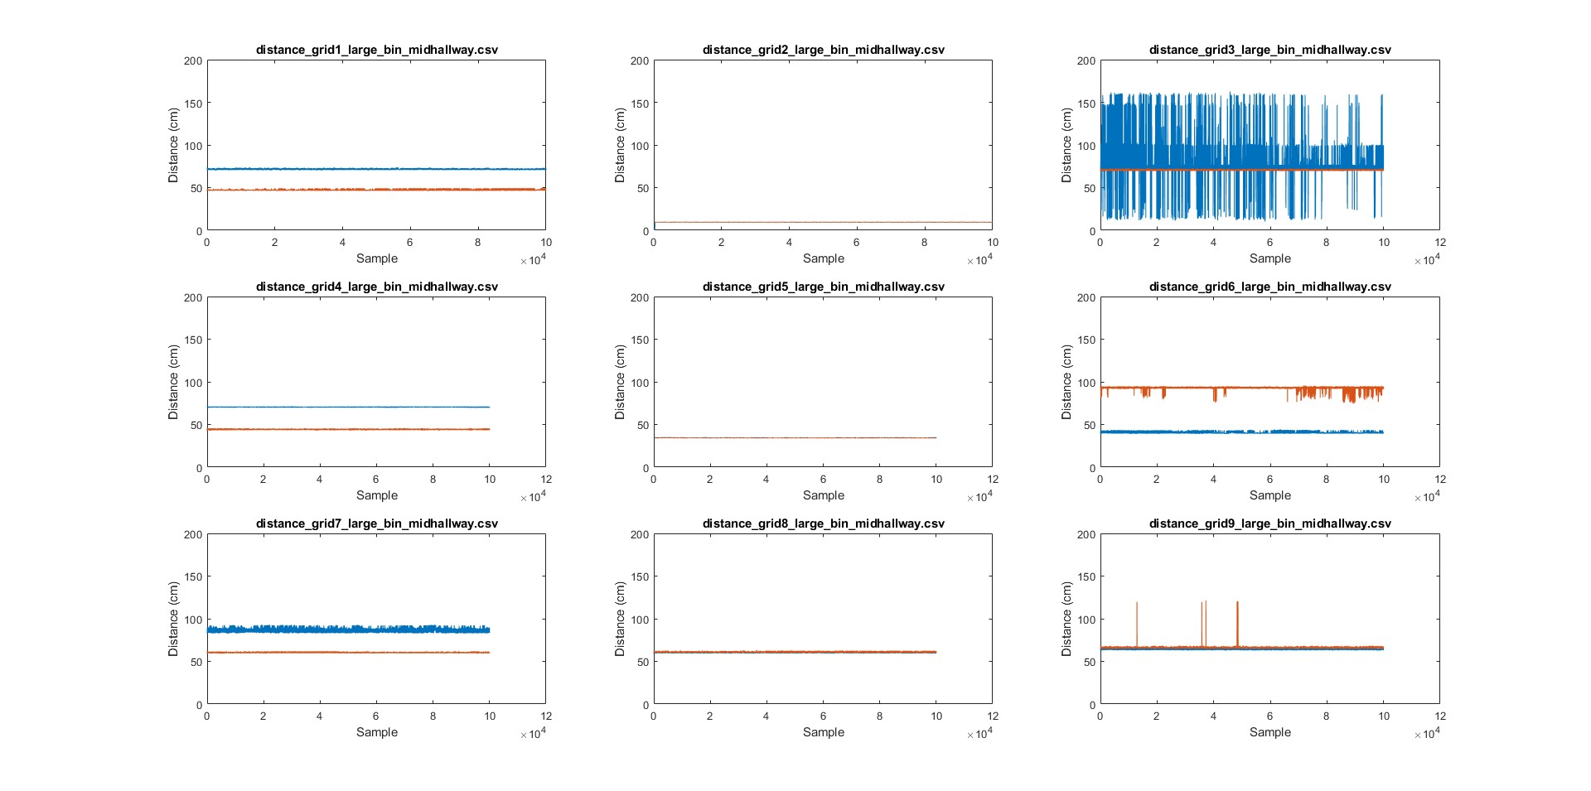
Large Narrow Bin (Area A)
X

Slide 8
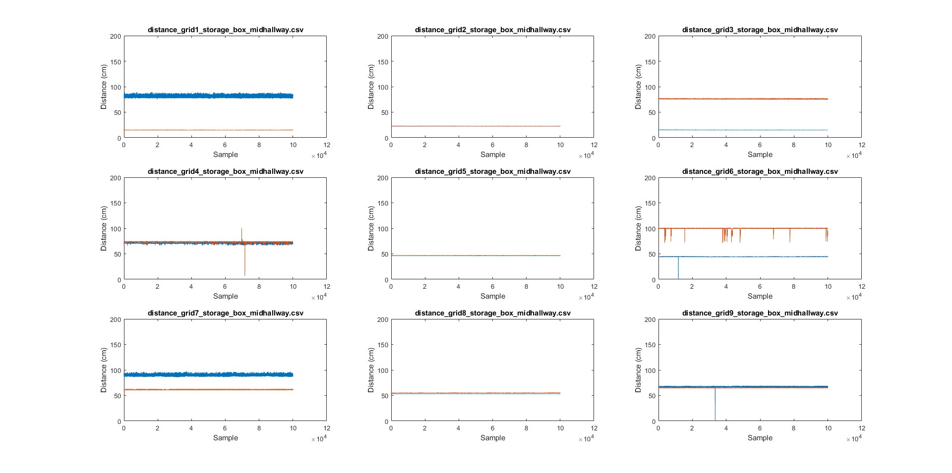
Storage Box (Area A)
X

Slide 9
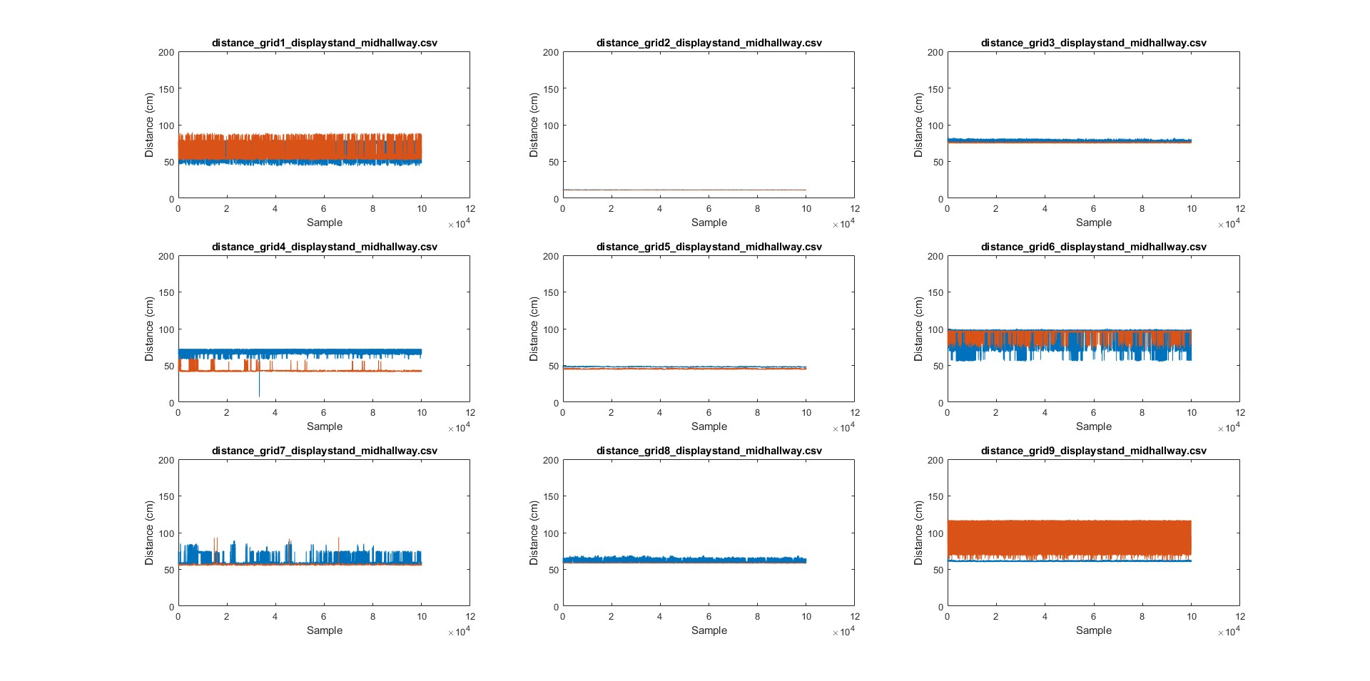
Display Stand (Area A)
X

Slide 10
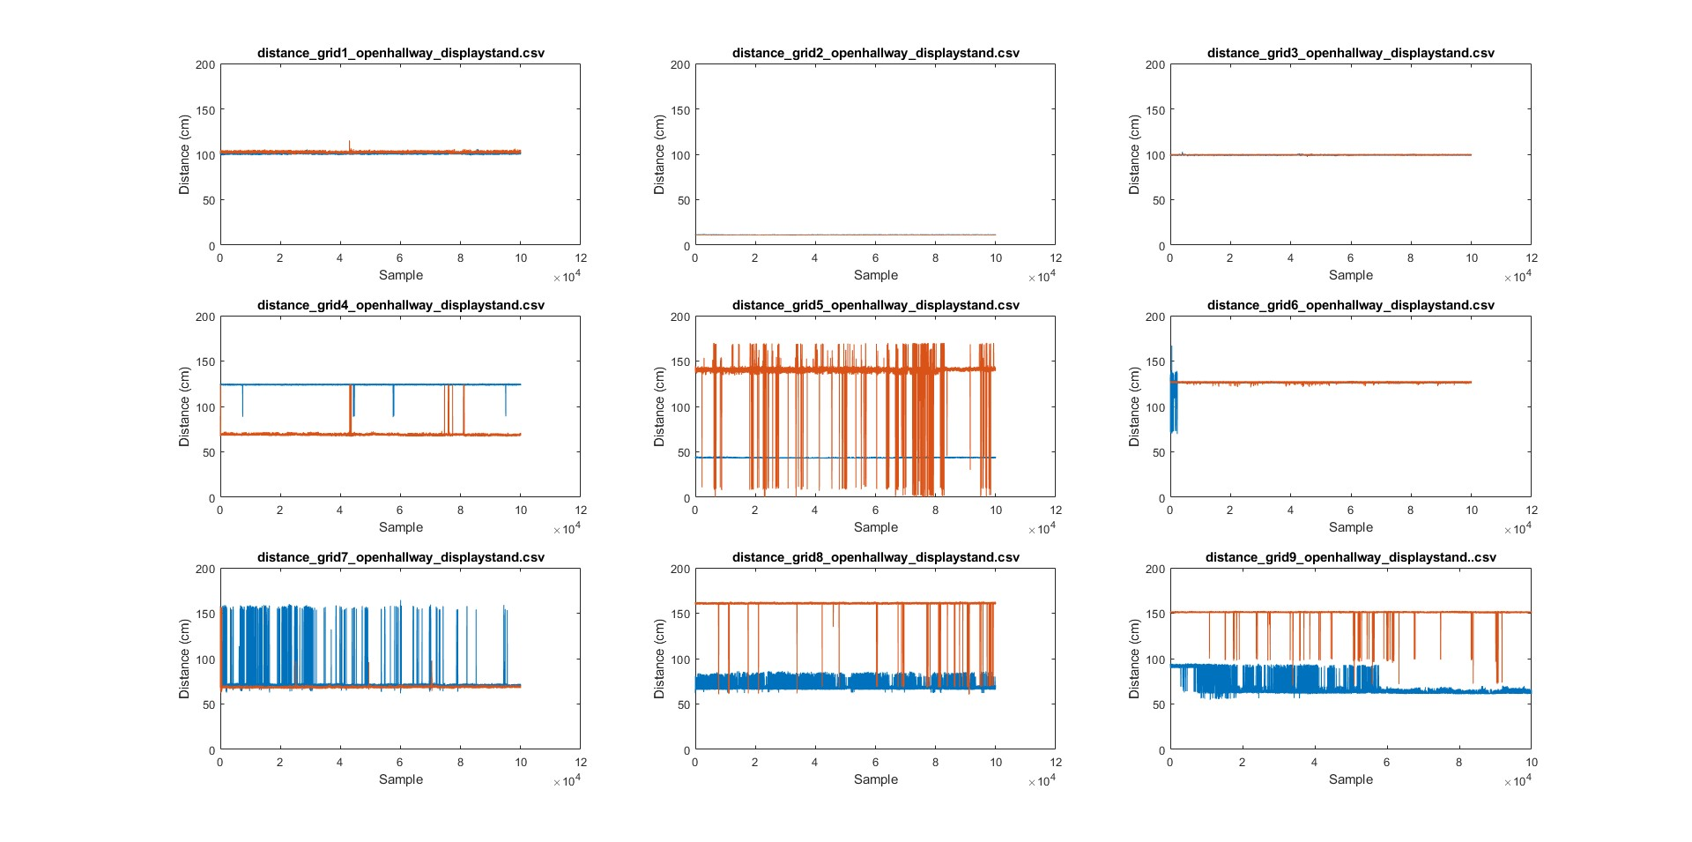
Display Stand (Area B)
X

Slide 11
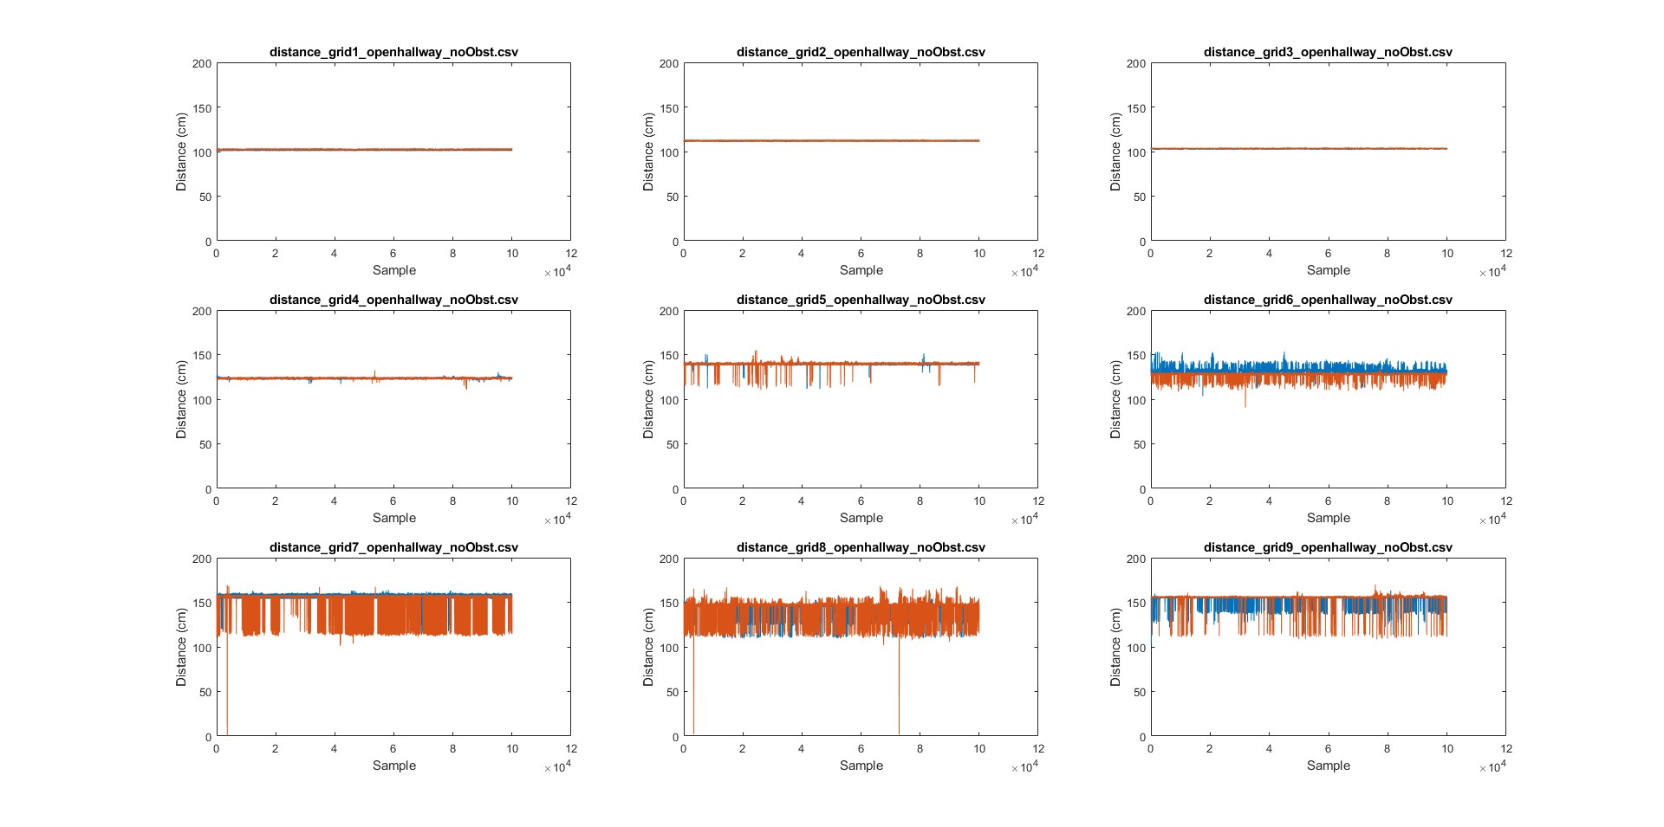
Display Stand (Area B)
X

